Slide 1
AutoEval: Predictive Modeling for Used Car Pricing
By PAVAN YELLATHAKOTA NAGARAJU MYDAM

Slide 2
CONTENTS
Objective
Data Collection and Preprocessing
Exploratory Data Analysis (EDA)
Feature Engineering
Model Selection
Model Training
Model Evaluations

Slide 3
Objective
To Maximize the Profits in the Used Car Market
To Enhance the Market Efficiency
To Empower Sellers with Data-Driven Insights

Slide 4
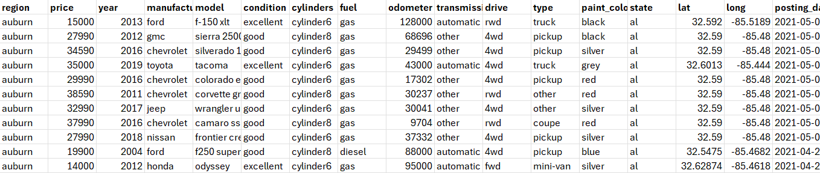
Data Collection
Source: https://www.kaggle.com/datasets/austinreese/craigslist-carstrucks-data

Slide 5
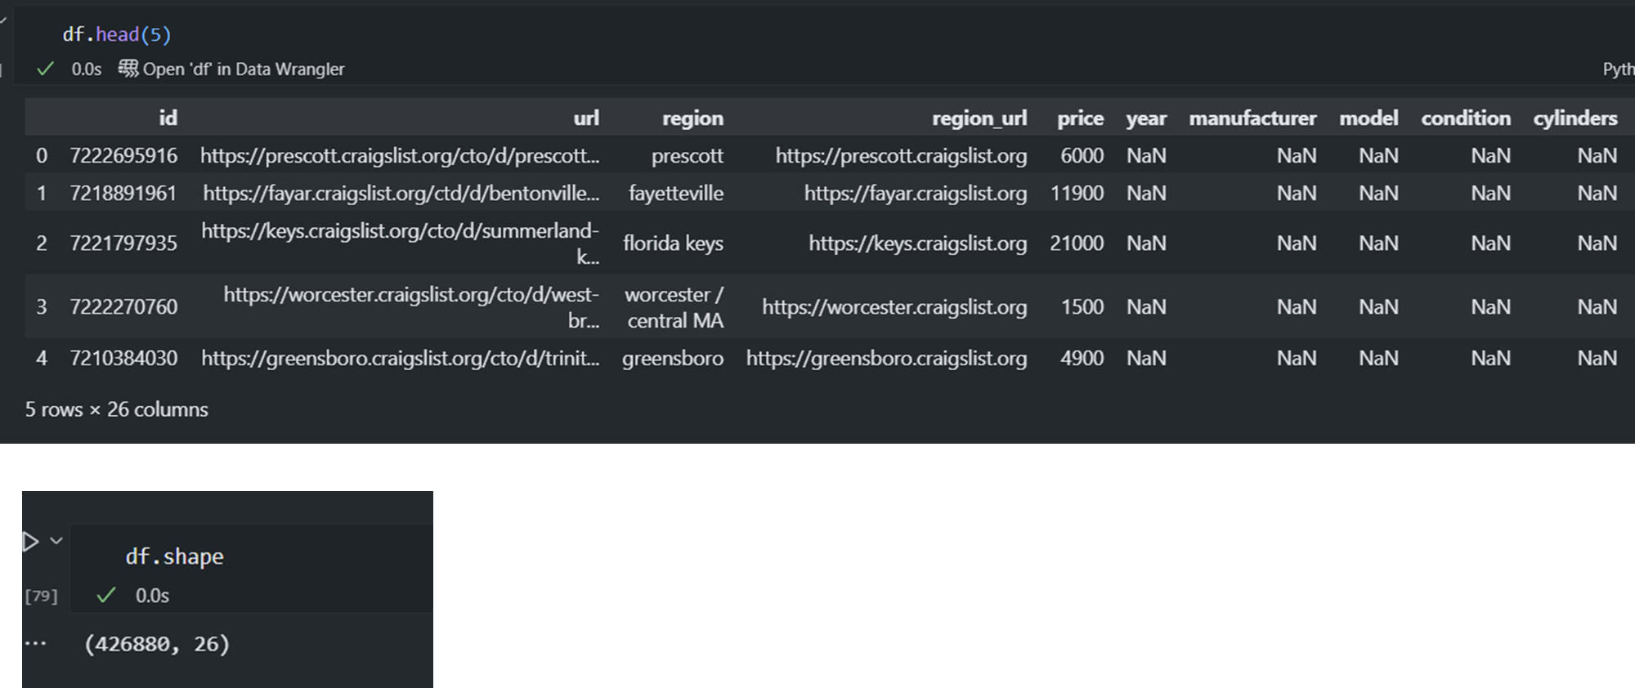
Data Preprocessing

Slide 6
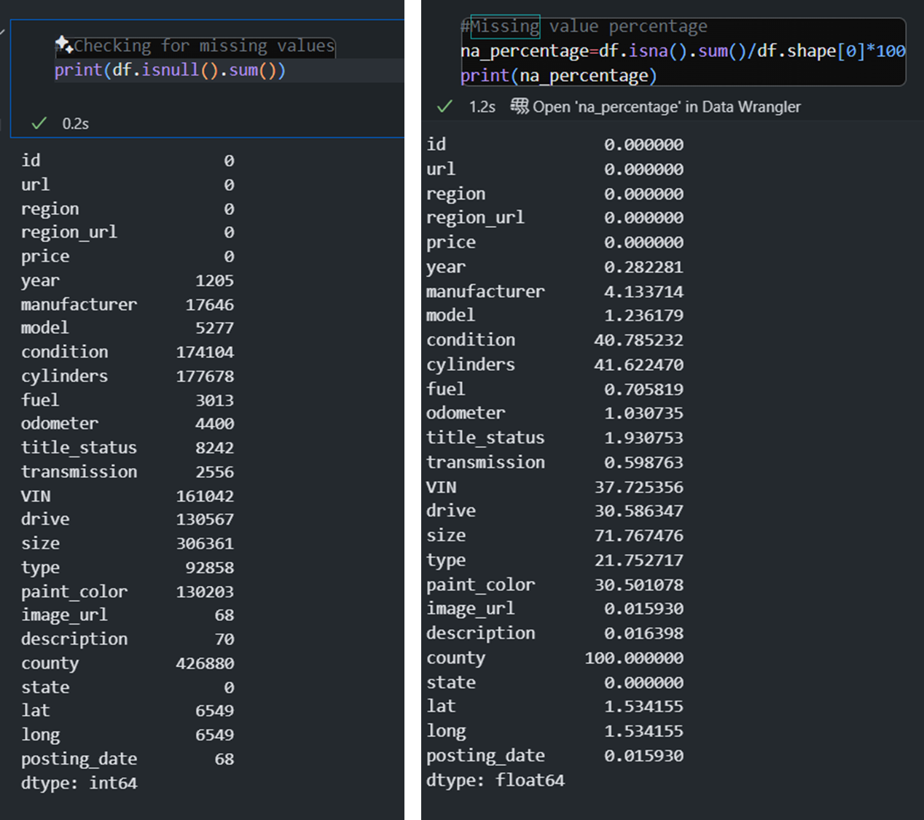
Missing Values

Slide 7
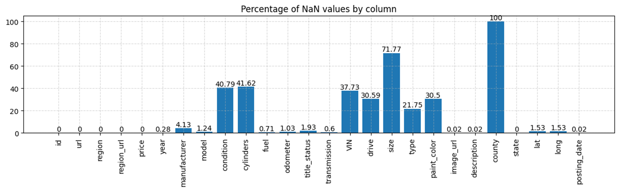
Cont…

Slide 8
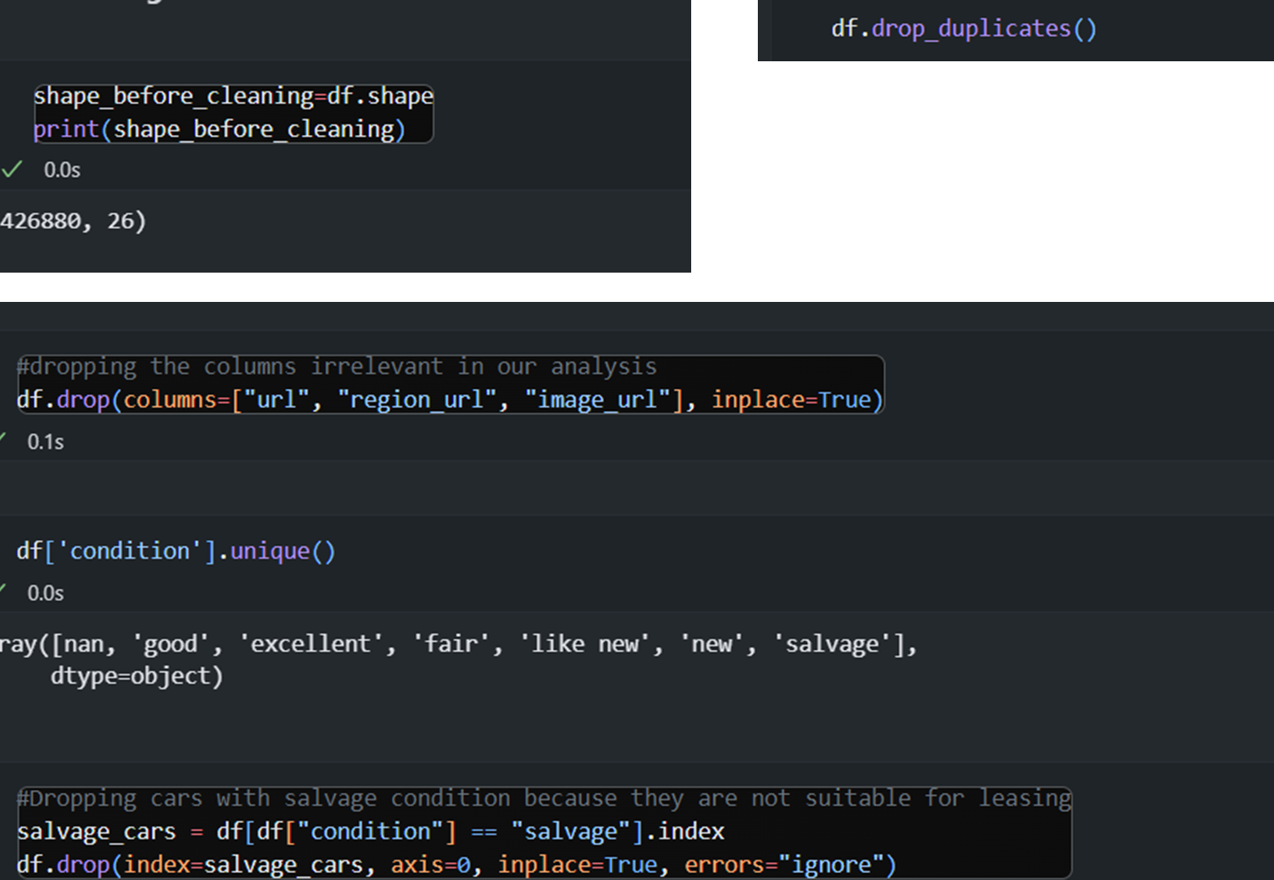
Data Cleaning

Slide 9
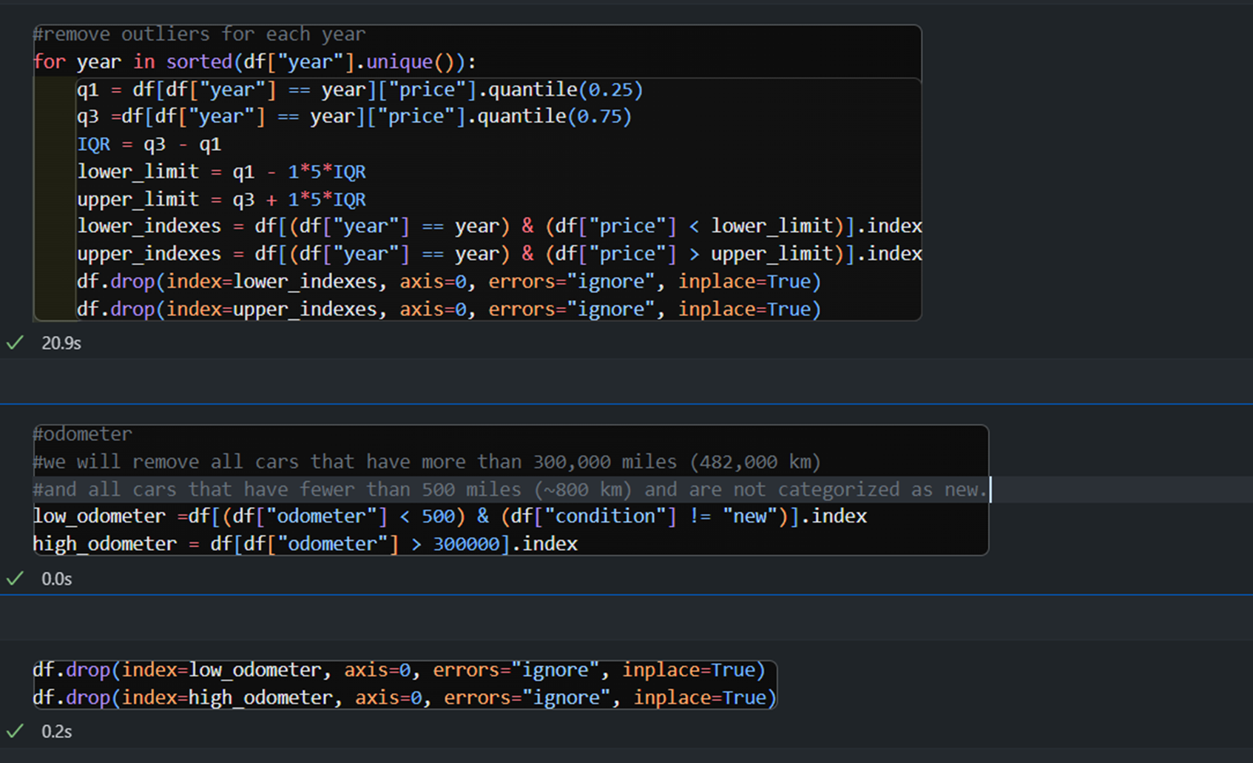
Cont…

Slide 10
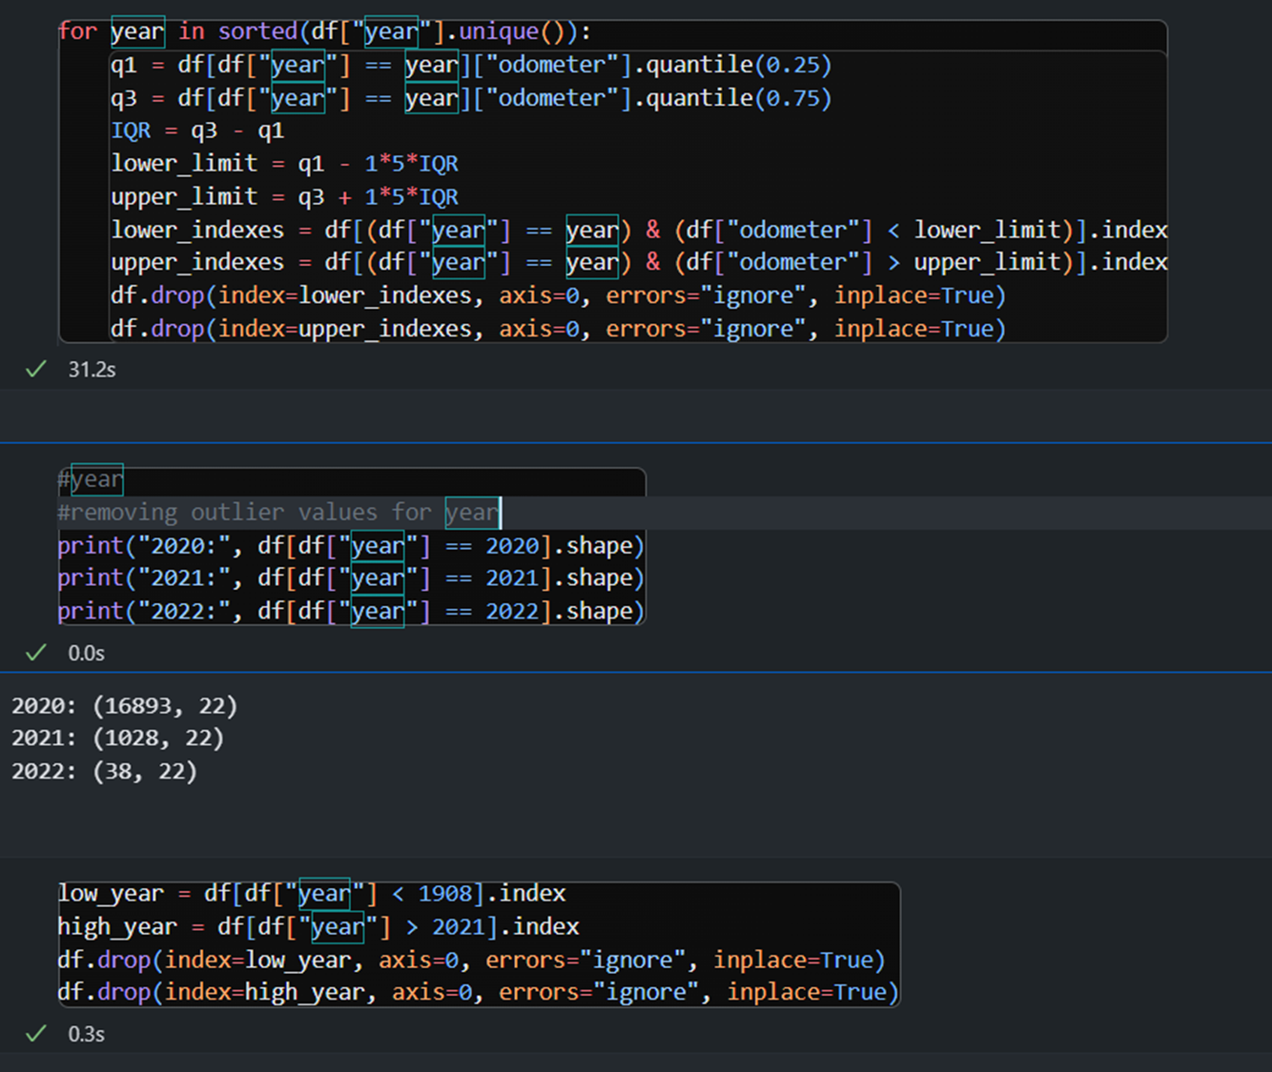
Cont..

Slide 11
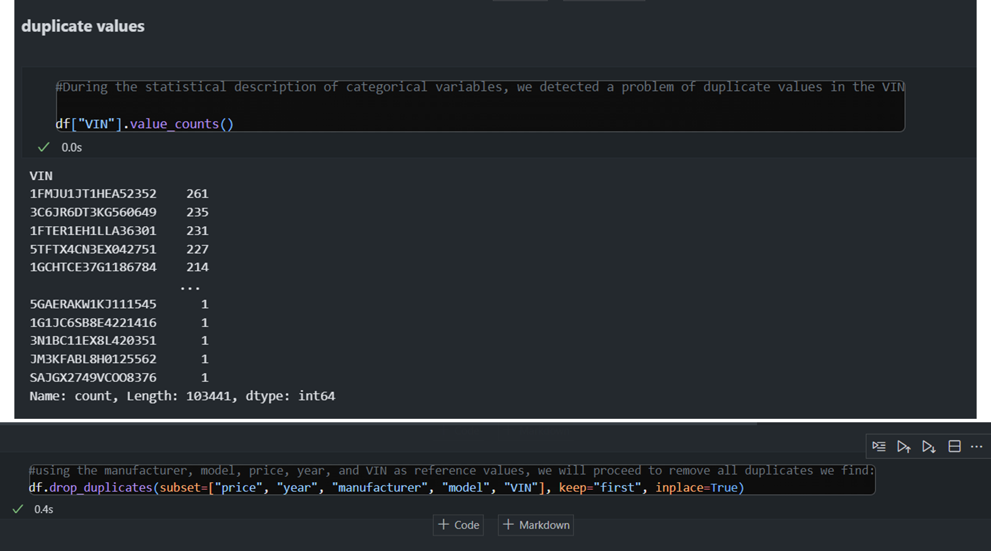
Dealing Duplicates

Slide 12
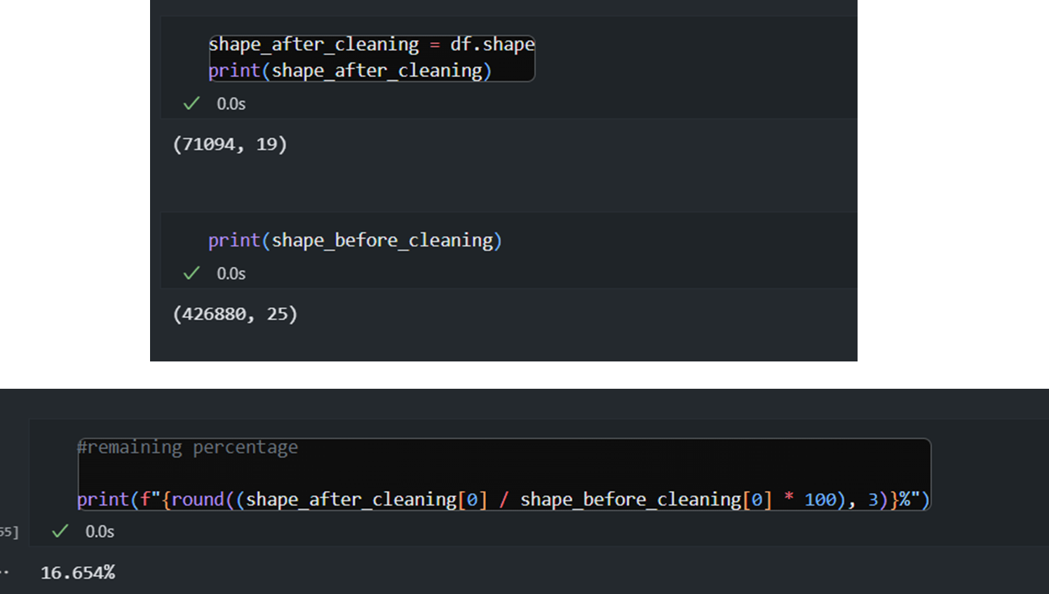
Cont..

Slide 13
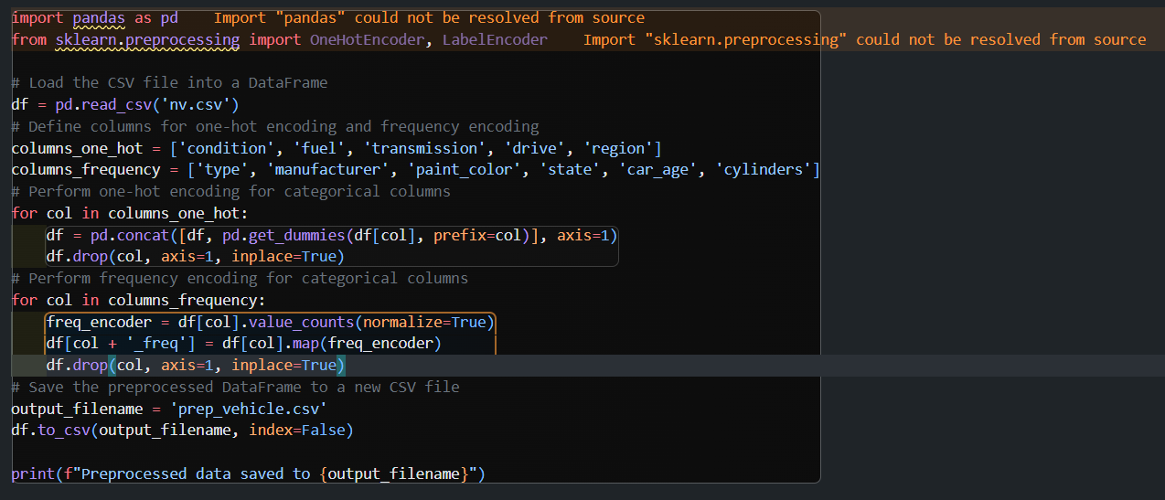
Feature Engineering

Slide 14
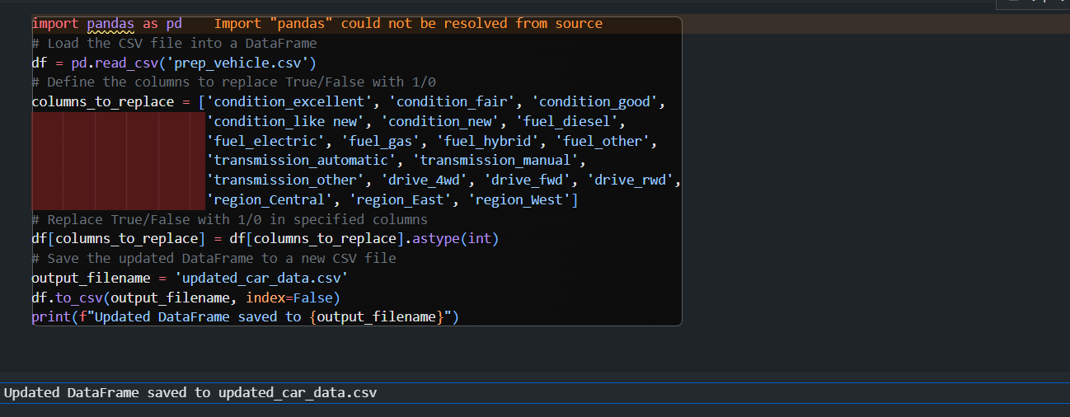
Cont..

Slide 15
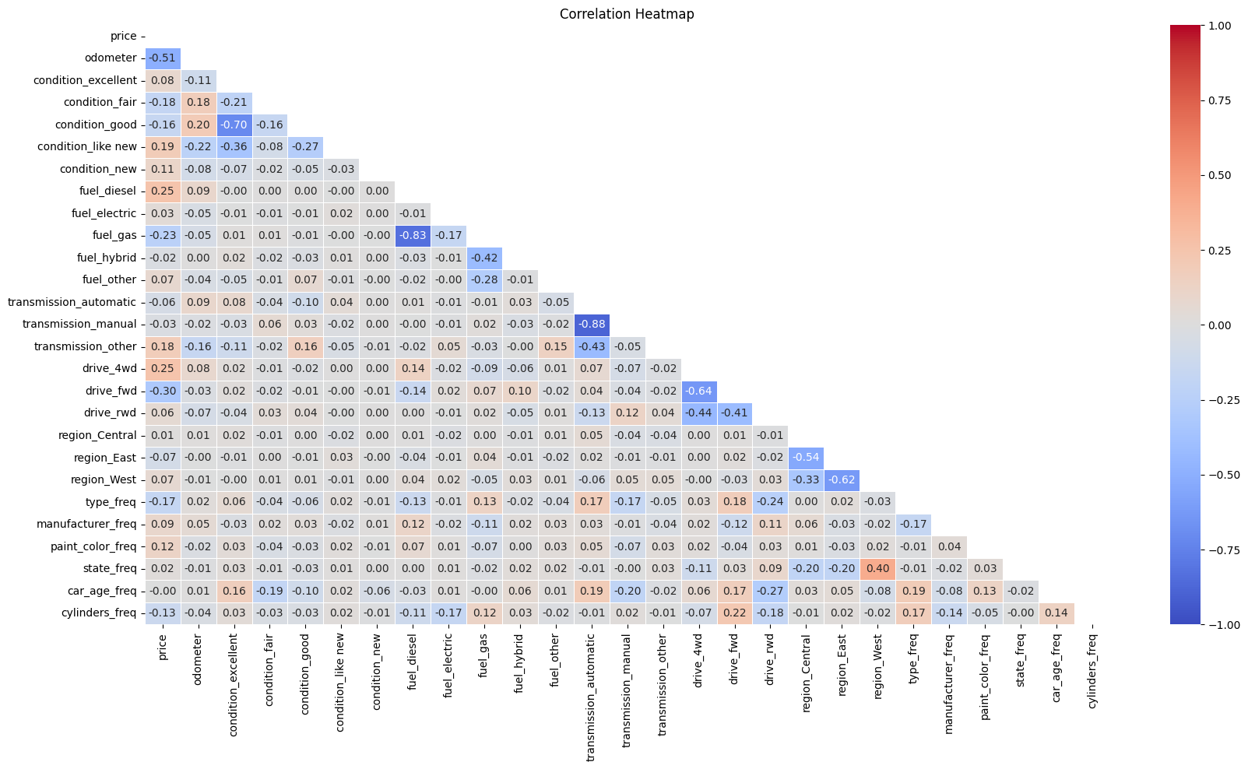
HeatMap

Slide 16
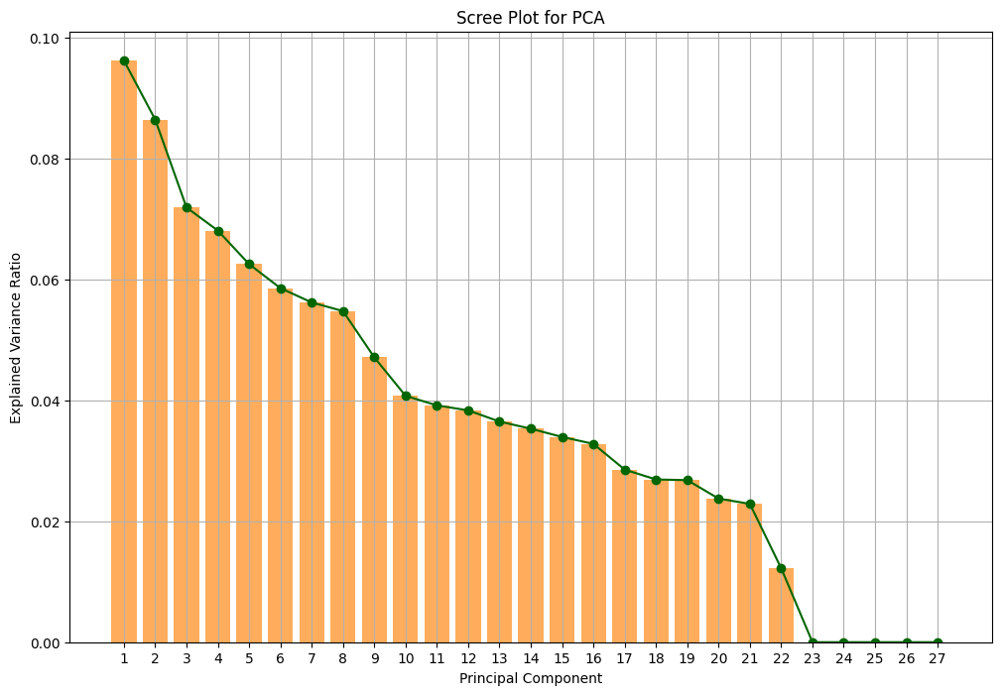
Plotting PCA Scree

Slide 17
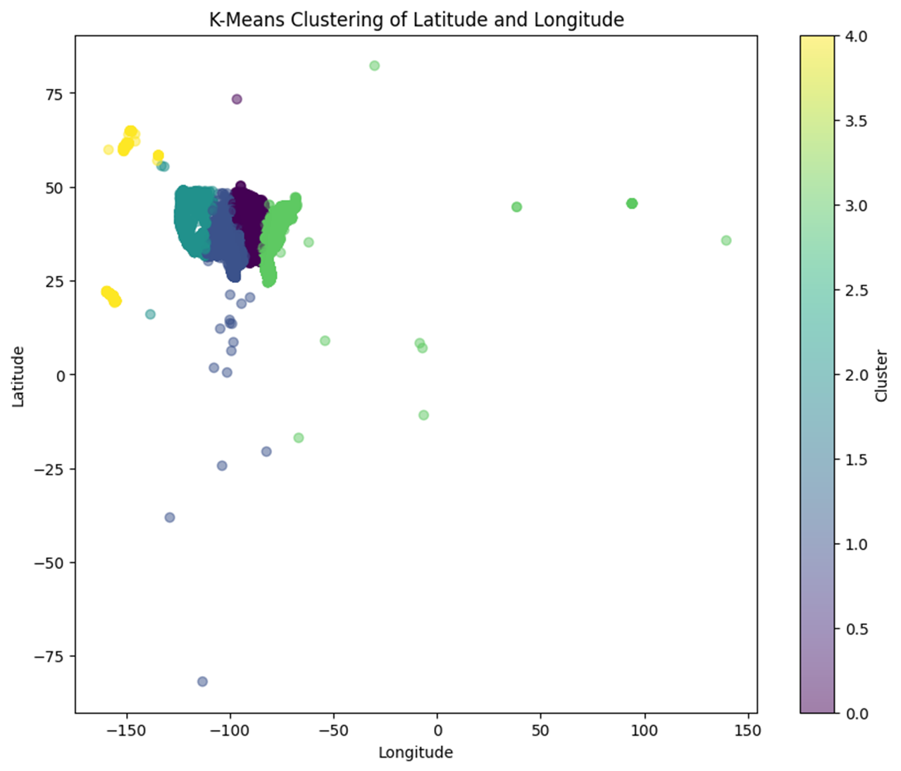
Clustering Data

Slide 18
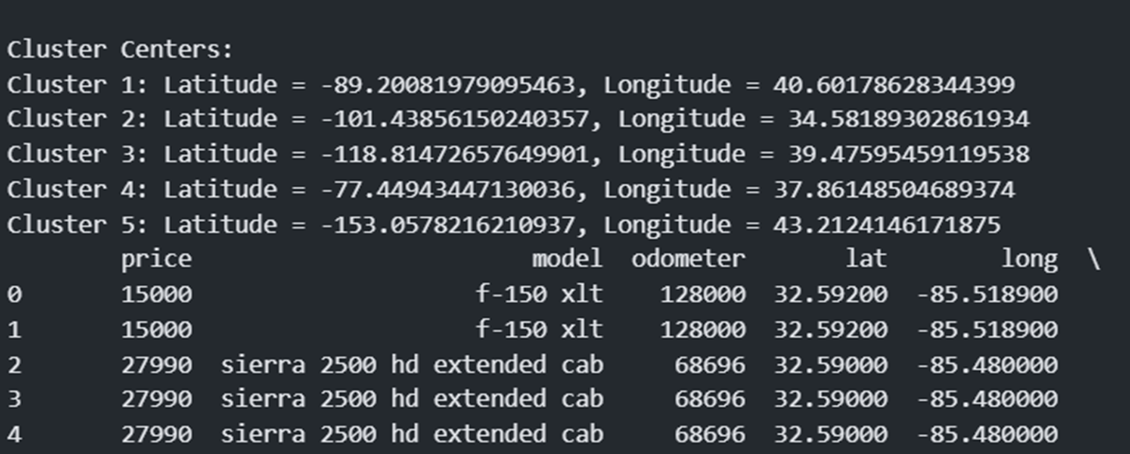
Clusters

Slide 19
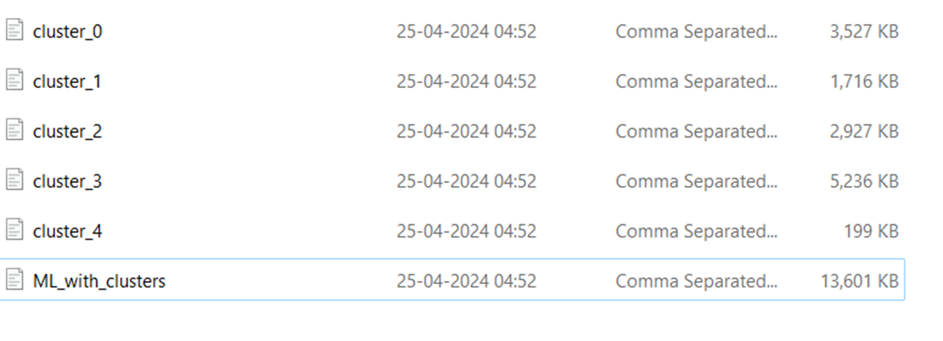
Clustered Datasets

Slide 20
Model Selection
Linear Regression
Decision Tree
Random Forest
XGBoost

Slide 21
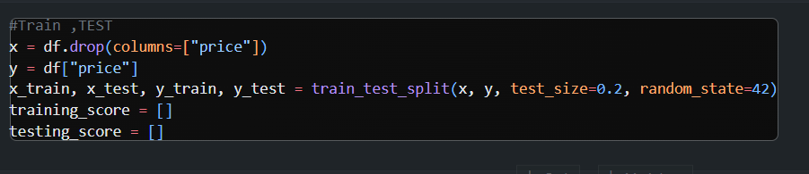
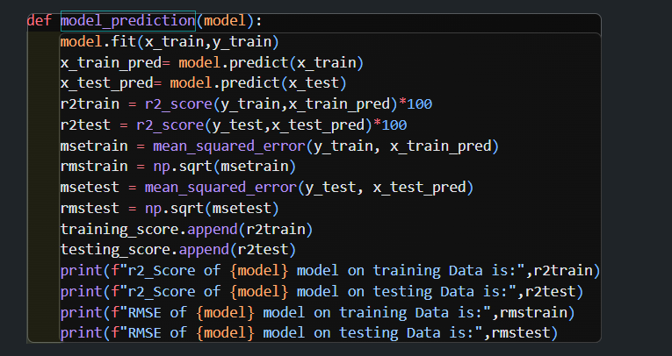
Train-Test Split

Slide 22
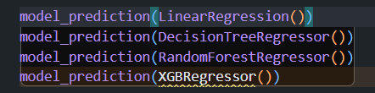
Model Training

Slide 23
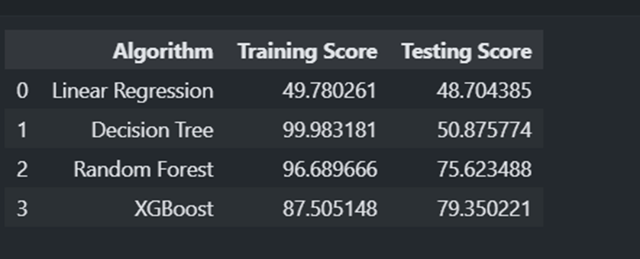
Model Evaluation on Complete Data

Slide 24
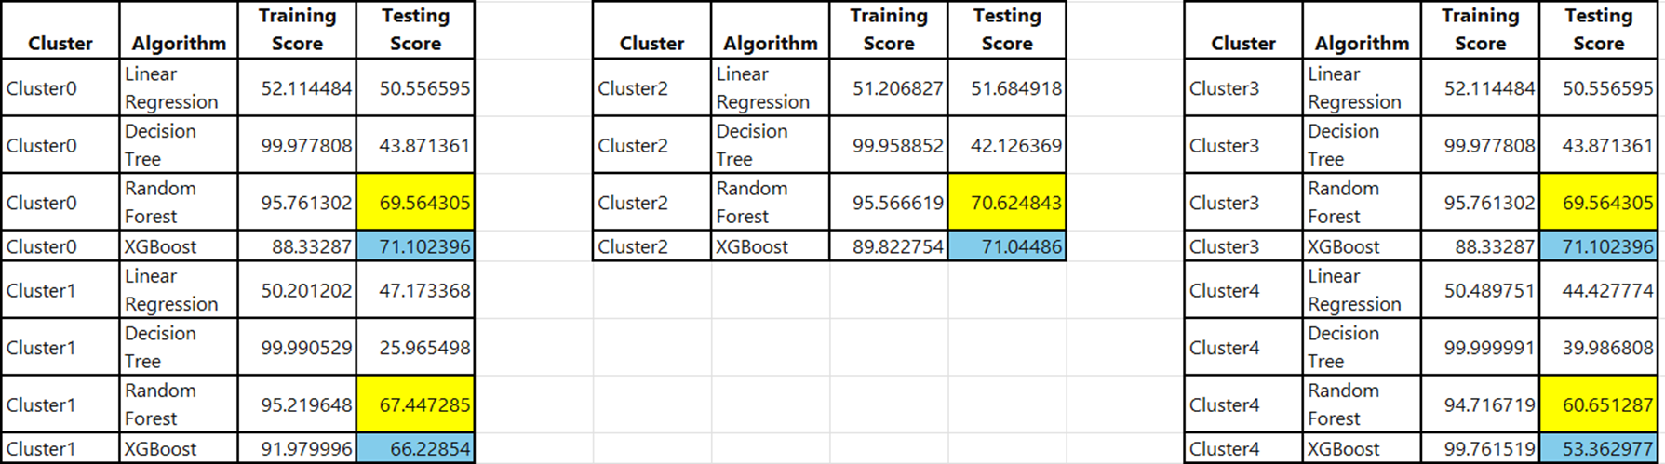
Model Evaluation on Various Clusters

